Slide 1




Study on Effect and efficacy of different AIDS treatment protocols
Computation Math and Statistics Final Project

Slide 2
Agenda
Introduction
Understanding the Data and Context
Process of the Study
Treatment Efficacy Analysis and Findings
  Based on survival outcome
  Based on c4 count
  Based on Immunity
Identifying the Best (or Worst) Treatment Group(s)
Conclusion
Appendix

Slide 3
Introduction
Research Question
Evaluation of the effect and efficacy of different AIDS treatment protocols across diverse patient demographics
Treatment protocols:
  Zidovudine alone (ZDV)
  Zidovudine and Didanosine (ZDV + ddI)
  Zidovudine plus zalcitabine (ZDV + ZaL)
  Didanosine alone (ddI)
Data Collection
Experimental Study on Volunteer AIDS patients (12 years or older) for a period of at least 2 years
Double Masking Study
Exclusion Criteria
  Co-existing Condition: Other AIDS-related conditions
  Concurrent Medication: Biologic response modifiers
  Concurrent Treatment: Radiotherapy
  Prior Medication: For other ailments within last 14 days
Sources
UC Irvene Machine Learning Repository
National Institute of Allergy and Infectious Diseases (NIAID) – ClinicalTrials
Hammer SM, Katzenstein DA, Hughes MD, Gundacker H, Schooley RT, Haubrich RH, Henry WK, Lederman MM, Phair JP, Niu M, Hirsch MS, Merigan TC. A trial comparing nucleoside monotherapy with combination therapy in HIV-infected adults with CD4 cell counts from 200 to 500 per cubic millimeter. AIDS Clinical Trials Group Study 175 Study Team. N Engl J Med. 1996 Oct 10;335(15):1081-90. doi: 10.1056/NEJM199610103351501. PMID: 8813038.

Slide 4
Understanding the Data and Context(1/3)
25 columns in the table
9 Numerical Columns and 15 Categorical Columns
pid – ID column and cid – Response variable
2139 records
Feature | Type | Description | Sample Values
pid | Numerical | Unique ID for each patient | 10056, 10059, …
cid | Categorial | Censoring indicator | 0=censored, 1=died
time | Numerical | time to failure or censoring | 948, 1002, …
trt | Categorical | treatment indicator | 0 = ZDV only; 1 = ZDV + ddI, 2 = ZDV + Zal, 3 = ddI only
age | Numerical | age (yrs) at baseline | 48, 61, …
wtkg | Numerical | weight (kg) at baseline | 89.8128, 49.4424, …
hemo | Categorical | hemophilia | 0=no, 1=yes
homo | Categorical | homosexual activity | 0=no, 1=yes
drugs | Categorical | history of IV drug use | 0=no, 1=yes
karnof | Numerical | Karnofsky score | on a scale of 0-100
oprior | Categorical | Non-ZDV antiretroviral therapy pre-175 | 0=no, 1=yes
z30 | Categorical | ZDV in the 30 days prior to 175 | 0=no, 1=yes
zprior | Categorical | ZDV prior to 175 | 0=no, 1=yes
preanti | Numerical | # days pre-175 anti-retroviral therapy | 0, 895, …
race | Categorical | race | 0=White, 1=non-white
gender | Categorical | gender | 0=F, 1=M
str2 | Categorical | antiretroviral history | 0=naive, 1=experienced
strat | Categorical | antiretroviral history stratification | 1='Antiretroviral Naive',2='> 1 but <= 52 weeks of prior antiretroviral therapy',3='> 52 weeks
symptom | Categorical | symptomatic indicator | 0=asymp, 1=symp
treat | Categorical | treatment indicator | 0=ZDV only, 1=others
offtrt | Categorical | indicator of off-trt before 96+/-5 weeks | 0=no,1=yes
cd40 | Numerical | CD4 at baseline | 422, 162, …
cd420 | Numerical | CD4 at 20+/-5 weeks | 477, 218, …
cd80 | Numerical | CD8 at baseline | 566, 392, …
cd820 | Numerical | CD8 at 20+/-5 weeks | 324, 564, …

Slide 5
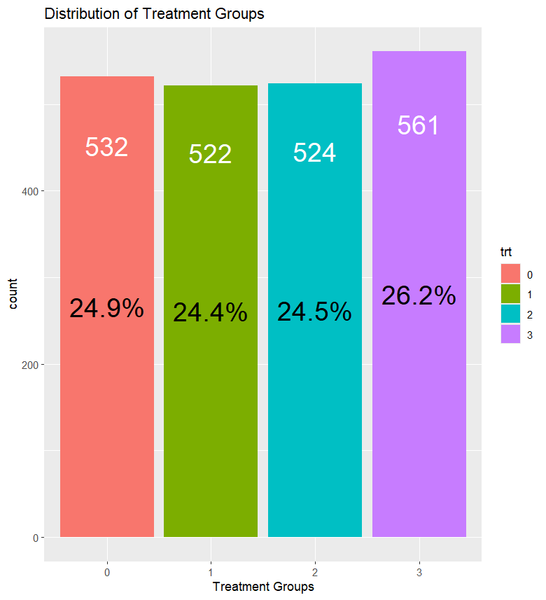
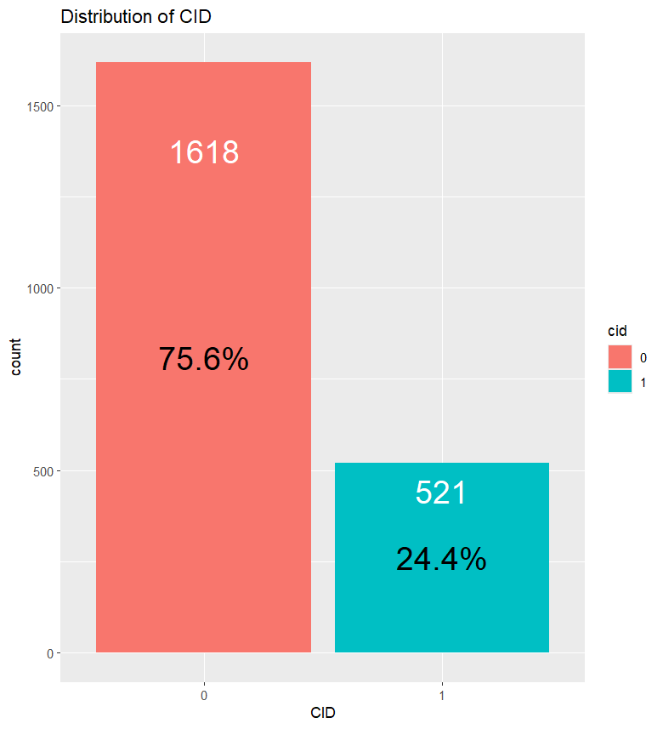
Understanding the Data and Context (2/3)
Imbalanced target variable with majority of the patients being alive (censored) during the period of the treatment
The Treatment groups have similar proportion of patients

Slide 6
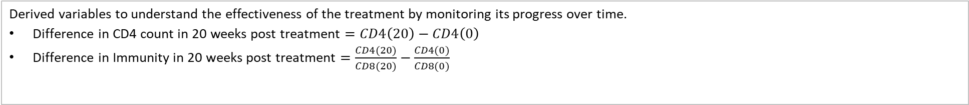
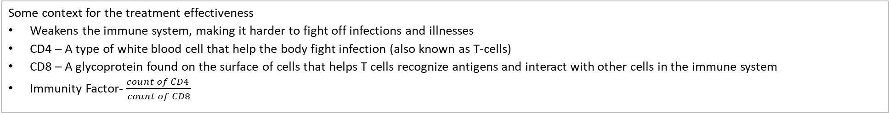
Understanding the Data and Context (3/3)
Some context for the treatment effectiveness
Weakens the immune system, making it harder to fight off infections and illnesses
CD4 – A type of white blood cell that help the body fight infection (also known as T-cells)
CD8 – A glycoprotein found on the surface of cells that helps T cells recognize antigens and interact with other cells in the immune system
Immunity Factor- $\frac{count of CD4 }{count of CD8}$
Derived variables to understand the effectiveness of the treatment by monitoring its progress over time.
$\text{Difference} \text{in} \text{CD}\text{4 }\text{count} \text{in}\text{ 20 }\text{weeks} \text{post} \text{treatment}=CD4\left(20\right)−CD4\left(0\right)$
$\text{Difference} \text{in} \text{Immunity} \text{in}\text{ 20 }\text{weeks} \text{post} \text{treatment}=\frac{CD4(20)}{CD8(20)}−\frac{CD4(0)}{CD8(0)}$
Summary - Difference in CD4 count in 20 weeks post treatment
Summary - Difference in Immunity in 20 weeks post treatment

Slide 7
Process of the Study
Data Selection
Formulation of Research Problem
EDA in the context of the Research Problem
Perform necessary Data Cleaning and Transformations
Identification of right statistical tests for the study
Perform the tests post stringent conditions verification for the test
Conclusion from the tests
Presentation to the Audience
Refine the Research problem based on EDA

Slide 8

Treatment Efficacy Analysis and Findings - Based on survival outcome (1/2)
Test Setup
Variables under consideration: Treatment Groups (trt) vs survival outcome (cid)
Variable types: Categorical vs Categorical
Statistical test: Chi-squared test (Testing for independence in two-way tables)
Confidence Level: 95% (𝛼=0.05)
Data for Test (Two Way Table)
Two Way Table with Expected Count
$$where, {Expected Count}_{ row i, col j}=\frac{row i total ×col j total}{table total}$$
Hypothesis
Null Hypothesis
  H₀: There is no difference in the efficacy of the three treatments. The survival outcome is independent of the treatment groups.
Alternative Hypothesis
  H_{A}: There is some difference in efficacy between the three treatments. The type of treatment given has some effect on the survival outcome

Slide 9
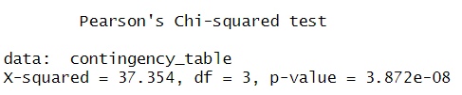
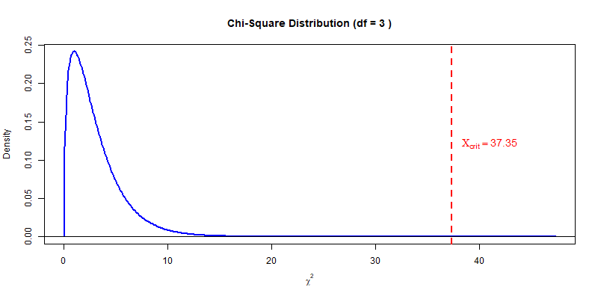
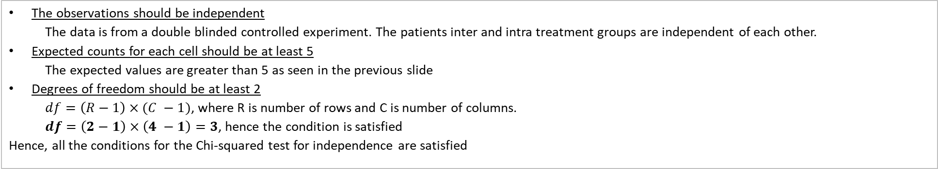
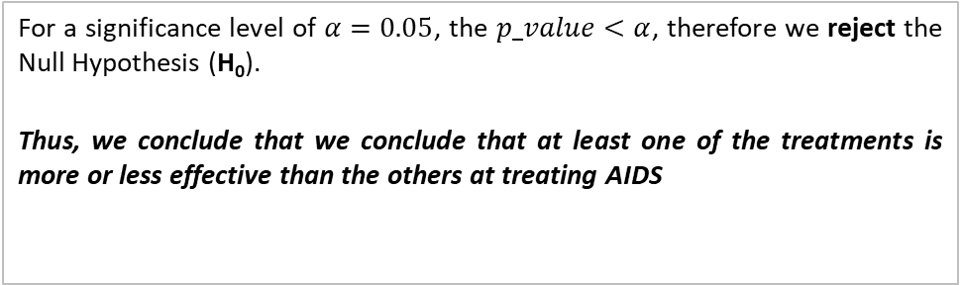
Treatment Efficacy Analysis and Findings - Based on survival outcome (2/2)
Conditions
The observations should be independent
  The data is from a double blinded controlled experiment. The patients inter and intra treatment groups are independent of each other.
Expected counts for each cell should be at least 5
  The expected values are greater than 5 as seen in the previous slide
Degrees of freedom should be at least 2
  $df=\left(R−1\right)×(C −1)$, where R is number of rows and C is number of columns.
  $df=\left(2−1\right)×\left(4 −1\right)=3$, hence the condition is satisfied
  Hence, all the conditions for the Chi-squared test for independence are satisfied
Test Outcome
Conclusion
For a significance level of $α=0.05$, the $p_value<α$, therefore we reject the Null Hypothesis (H₀).
Thus, we conclude that we conclude that at least one of the treatments is more or less effective than the others at treating AIDS

Slide 10
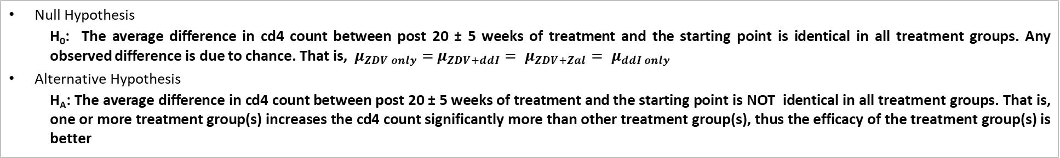
Treatment Efficacy Analysis and Findings - Based on c4 count (1/3)
Test Setup
Variables under consideration: Treatment Groups (trt) vs Difference in c4 count from 20 weeks to the start of the treatment (diff_cd4_from_baseline)
Variable types: Categorical vs Numerical
Statistical test: ANOVA and F-test (Comparing many means)
Confidence Level: 95% (𝛼=0.05)
Hypothesis
Null Hypothesis
  H₀: The average difference in cd4 count between post 20 ± 5 weeks of treatment and the starting point is identical in all treatment groups. Any observed difference is due to chance. That is, $μ_{ZDV only}=$ $μ_{ZDV+ddI}= μ_{ZDV+Zal}= μ_{ddI only}$
Alternative Hypothesis
  H_{A}: The average difference in cd4 count between post 20 ± 5 weeks of treatment and the starting point is NOT identical in all treatment groups. That is, one or more treatment group(s) increases the cd4 count significantly more than other treatment group(s), thus the efficacy of the treatment group(s) is better
Analysis

Slide 11
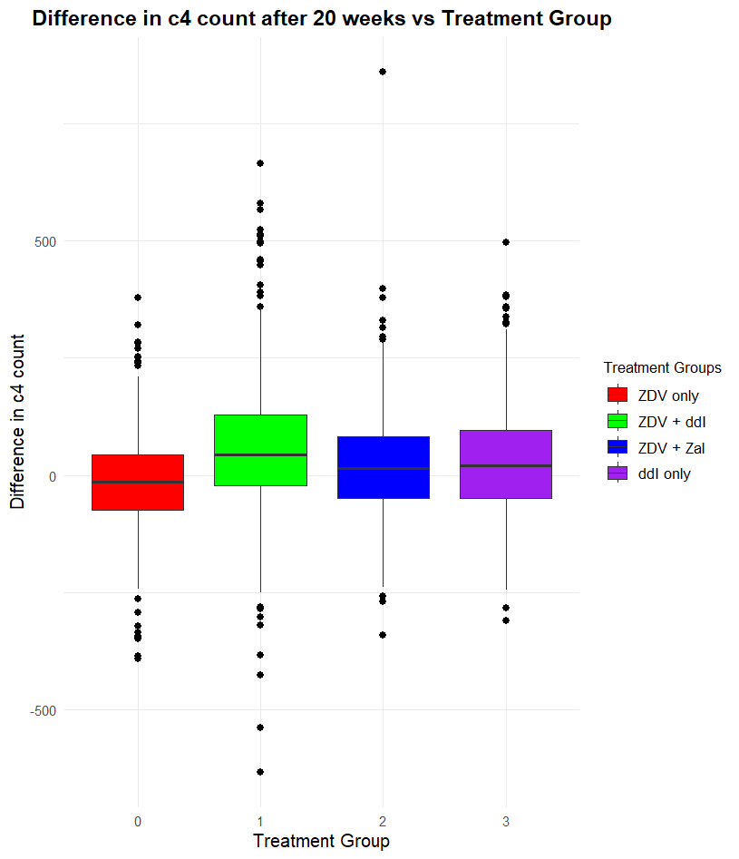
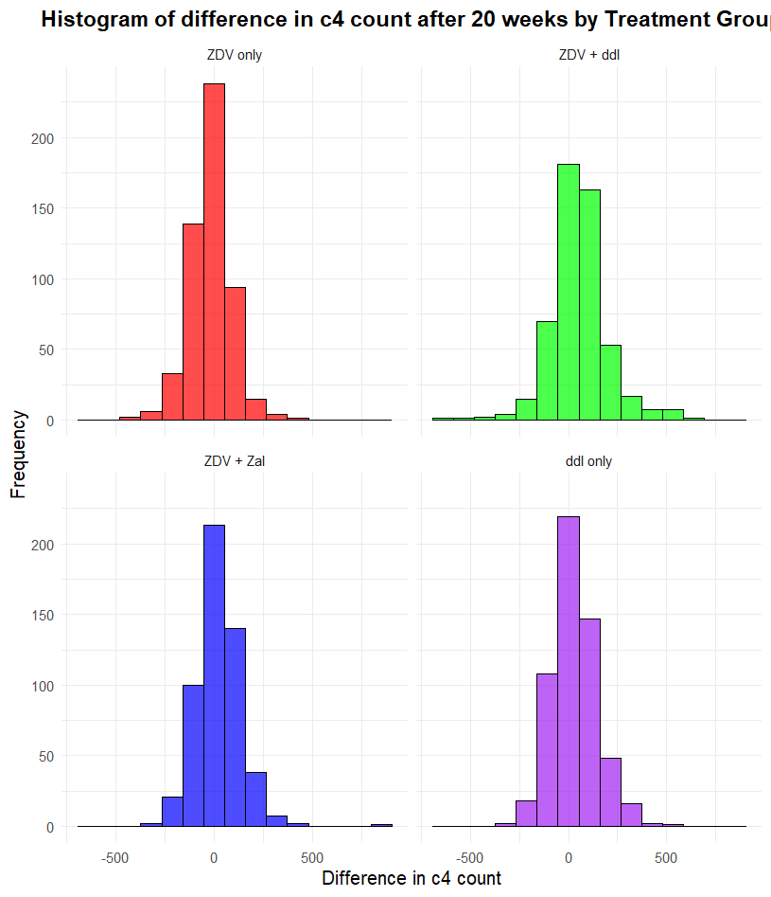
Treatment Efficacy Analysis and Findings - Based on c4 count (2/3)
Analysis (cont…)

Slide 12
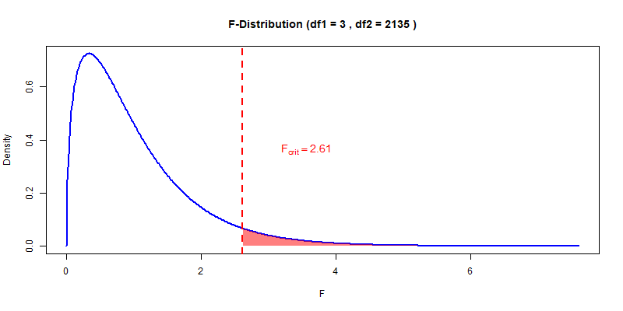
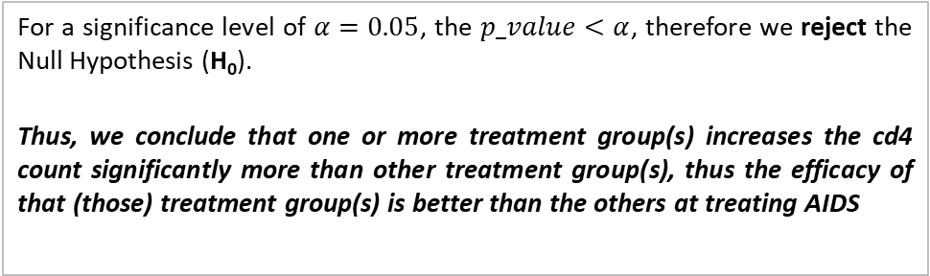
Treatment Efficacy Analysis and Findings - Based on c4 count (3/3)
Conditions
The observations should be independent within and across groups
  The data is from a double blinded controlled experiment. The patients inter and intra treatment groups are independent of each other
The data within each group are nearly normal
  As seen in the histogram, the data within each group are nearly normal and we don’t find any extreme outliers otherwise
The variability across the groups is about equal
  As seen in the box-plot and the summary table, the constant variance assumption appears to be reasonable
  Though the variance of ZDV + ddI is a bit higher than the rest of the groups, the range of deviations seems reasonable as we have enough sample size and we don’t have any extreme outliers, otherwise.
  Hence, all the conditions for the ANOVA and F-test for comparing many means are satisfied.
Test Outcome
Conclusion
For a significance level of $α=0.05$, the $p_value<α$, therefore we reject the Null Hypothesis (H₀).
Thus, we conclude that one or more treatment group(s) increases the cd4 count significantly more than other treatment group(s), thus the efficacy of that (those) treatment group(s) is better than the others at treating AIDS

Slide 13

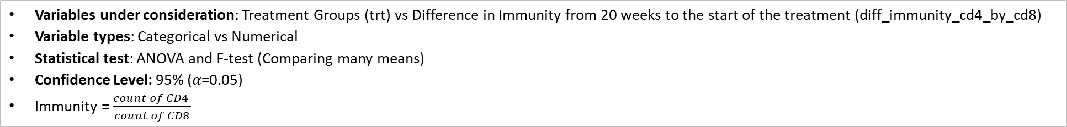
Treatment Efficacy Analysis and Findings - Based on Immunity (1/3)
Test Setup
Variables under consideration: Treatment Groups (trt) vs Difference in Immunity from 20 weeks to the start of the treatment (diff_immunity_cd4_by_cd8)
Variable types: Categorical vs Numerical
Statistical test: ANOVA and F-test (Comparing many means)
Confidence Level: 95% (𝛼=0.05)
Immunity = $\frac{count of CD4 }{count of CD8}$
Hypothesis
Null Hypothesis
  H₀: The average difference in immunity between post 20 ± 5 weeks of treatment and the starting point is identical in all treatment groups. Any observed difference is due to chance. That is, $μ_{ZDV only}=$ $μ_{ZDV+ddI}= μ_{ZDV+Zal}= μ_{ddI only}$
Alternative Hypothesis
  H_{A}: The average difference in immunity between post 20 ± 5 weeks of treatment and the starting point is NOT identical in all treatment groups. That is, one or more treatment group(s) increases the cd4 count significantly more than other treatment group(s), thus the efficacy of the treatment group(s) is better
Analysis

Slide 14
Treatment Efficacy Analysis and Findings - Based on Immunity (3/3)
Conditions
The observations should be independent within and across groups
  The data is from a double blinded controlled experiment. The patients inter and intra treatment groups are independent of each other
The data within each group are nearly normal
  As seen in the histogram, the data within each group are nearly normal. But for the ZDV + ddI treatment group, we can see some extreme outliers in the box plot as well as the histogram
The variability across the groups is about equal
  As seen in the box-plot and the summary table, the variance of ZDV + ddI is a very different than the rest of the groups
  Though we have enough sample size, but due to the presence of extreme outliers, we need to investigate the case and understand why such outcomes came by.
  The constant variance condition is not met
  All the conditions for the ANOVA and F-test for comparing many means are NOT satisfied.
Conclusion
Since the conditions are not satisfied, we cannot perform the ANOVA F-test on Immunity variable across the treatment groups

